Slide 1
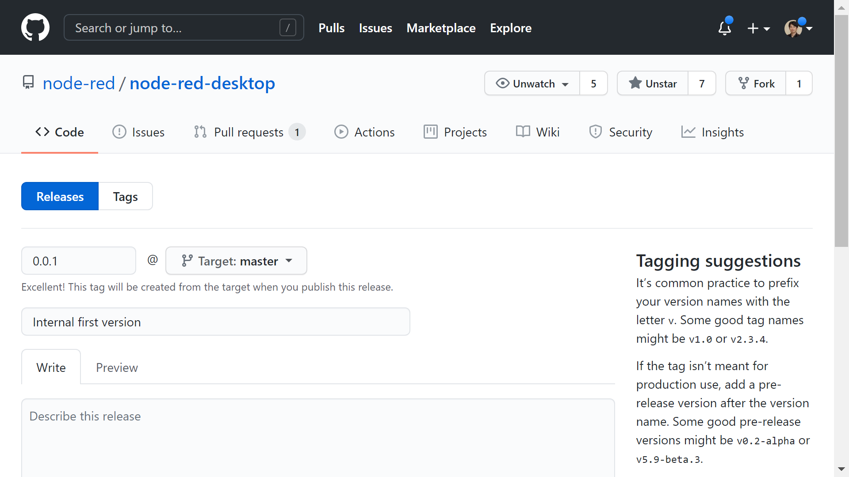
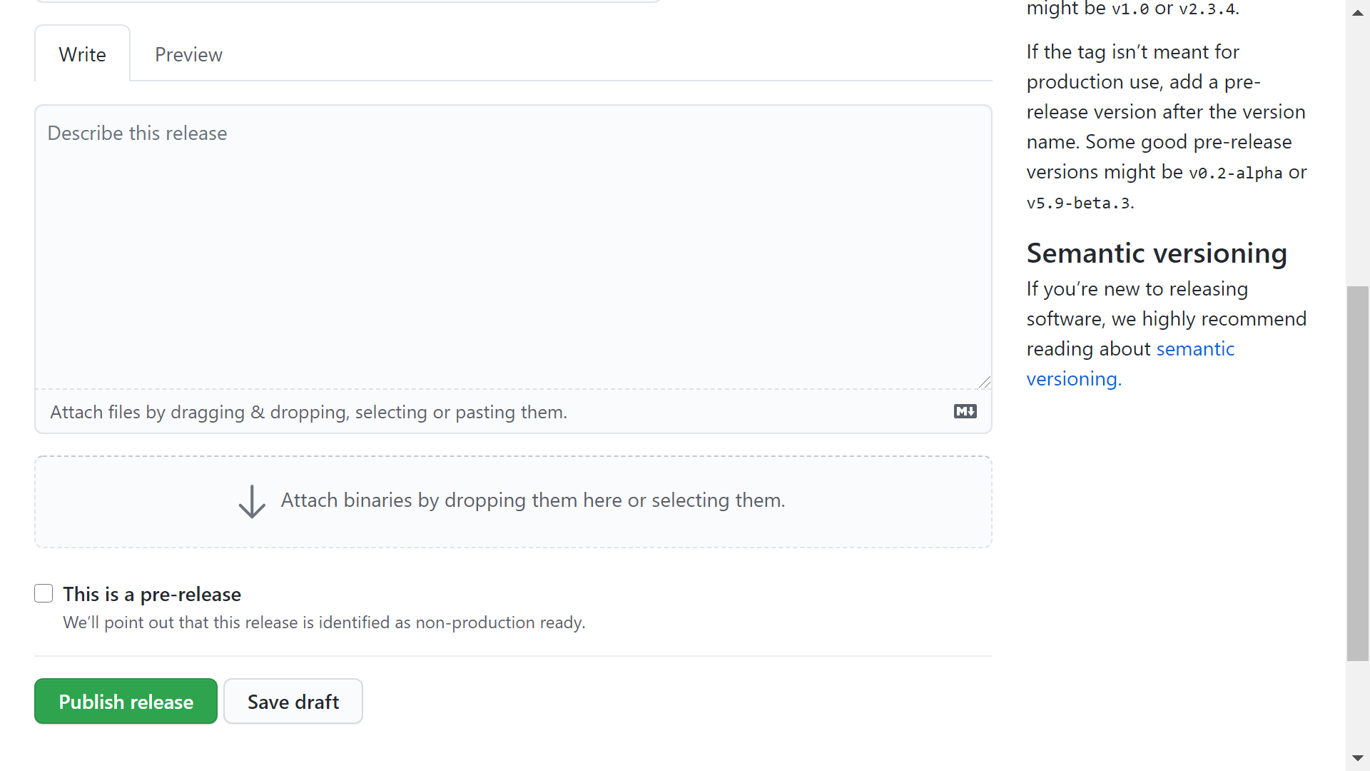

Standalone Node-RED
As the first step, we would like to release the internal first version.
After that, Saito-san’s functionalities idea will be used as the reference because it may be difficult to migrate the original project due to company policy.
I try to invite Saito-san to the project.
# | Question
1 | Can we release the internal first version in the timing when Node-RED v1.3 is released?
Windows
binary
macOS
binary

Slide 2
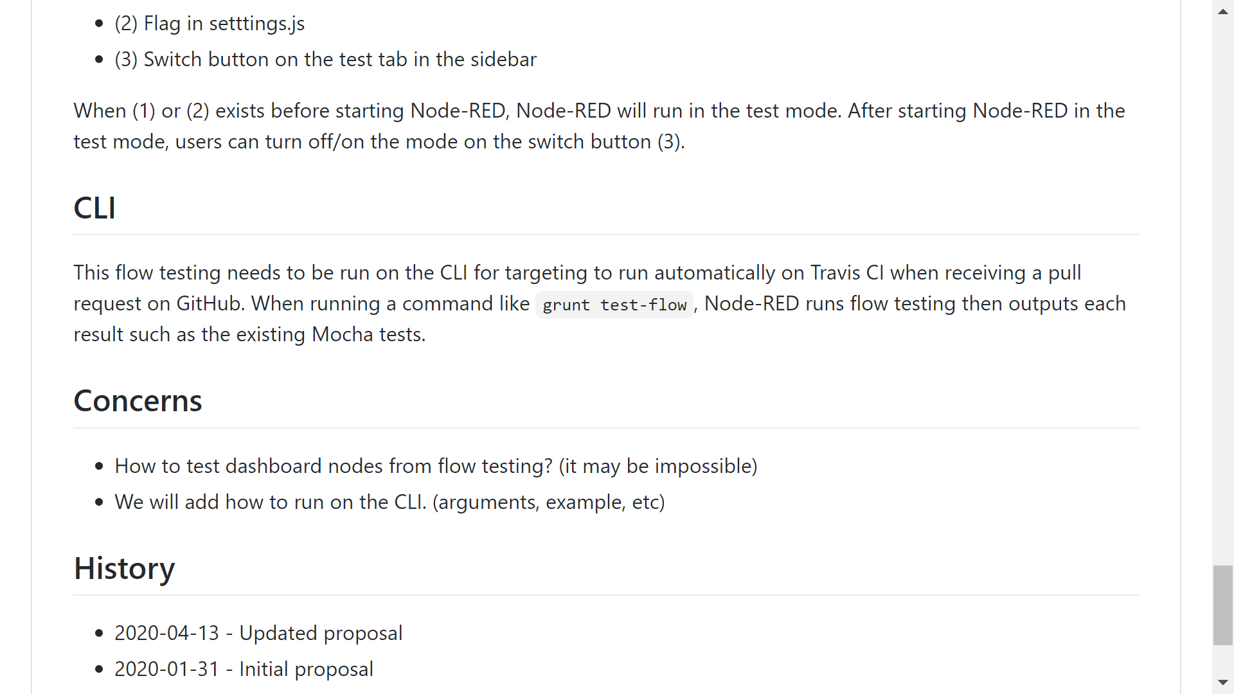
Testing flows
# | Question
1 | Can we start to develop the flow testing implementation for CLI
https://github.com/node-red-hitachi/designs/tree/flow-testing/designs/flow-testing

Slide 3

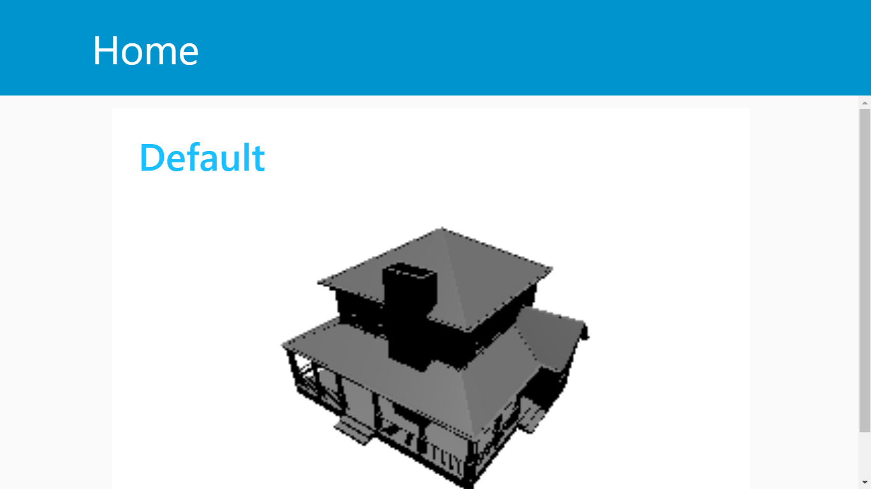
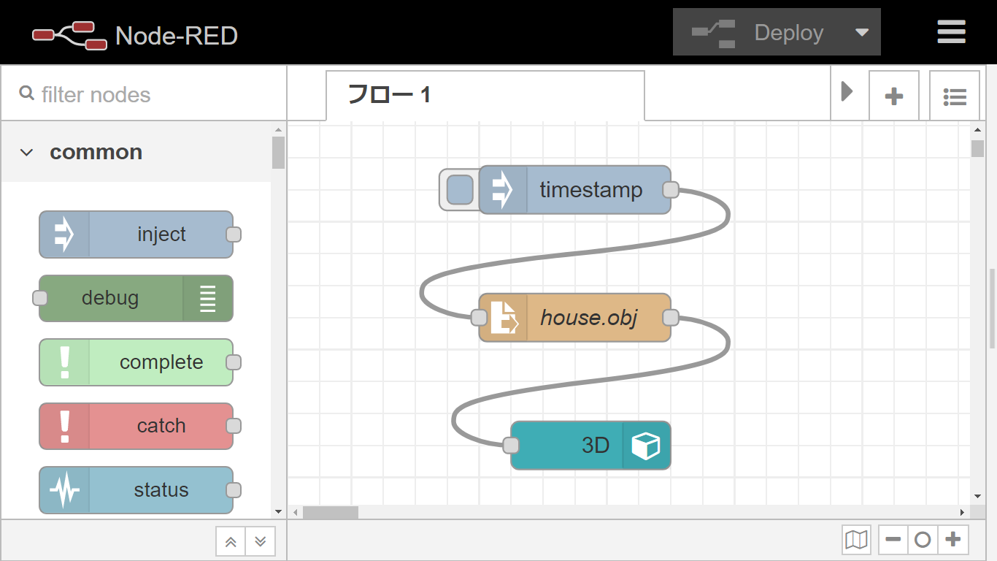
3D UI node (ui_3d) for Node-RED Dashboard
We started to create 3D UI node to visualize 3D object data.
In our plan, we will use the Node-RED dashboard for digital twin use cases.
https://free3d.com/3d-model/house-max-5151.html
# | Question
1 | Can we submit the 3D node to the node-red-ui-node repository after we developed it?

Slide 4
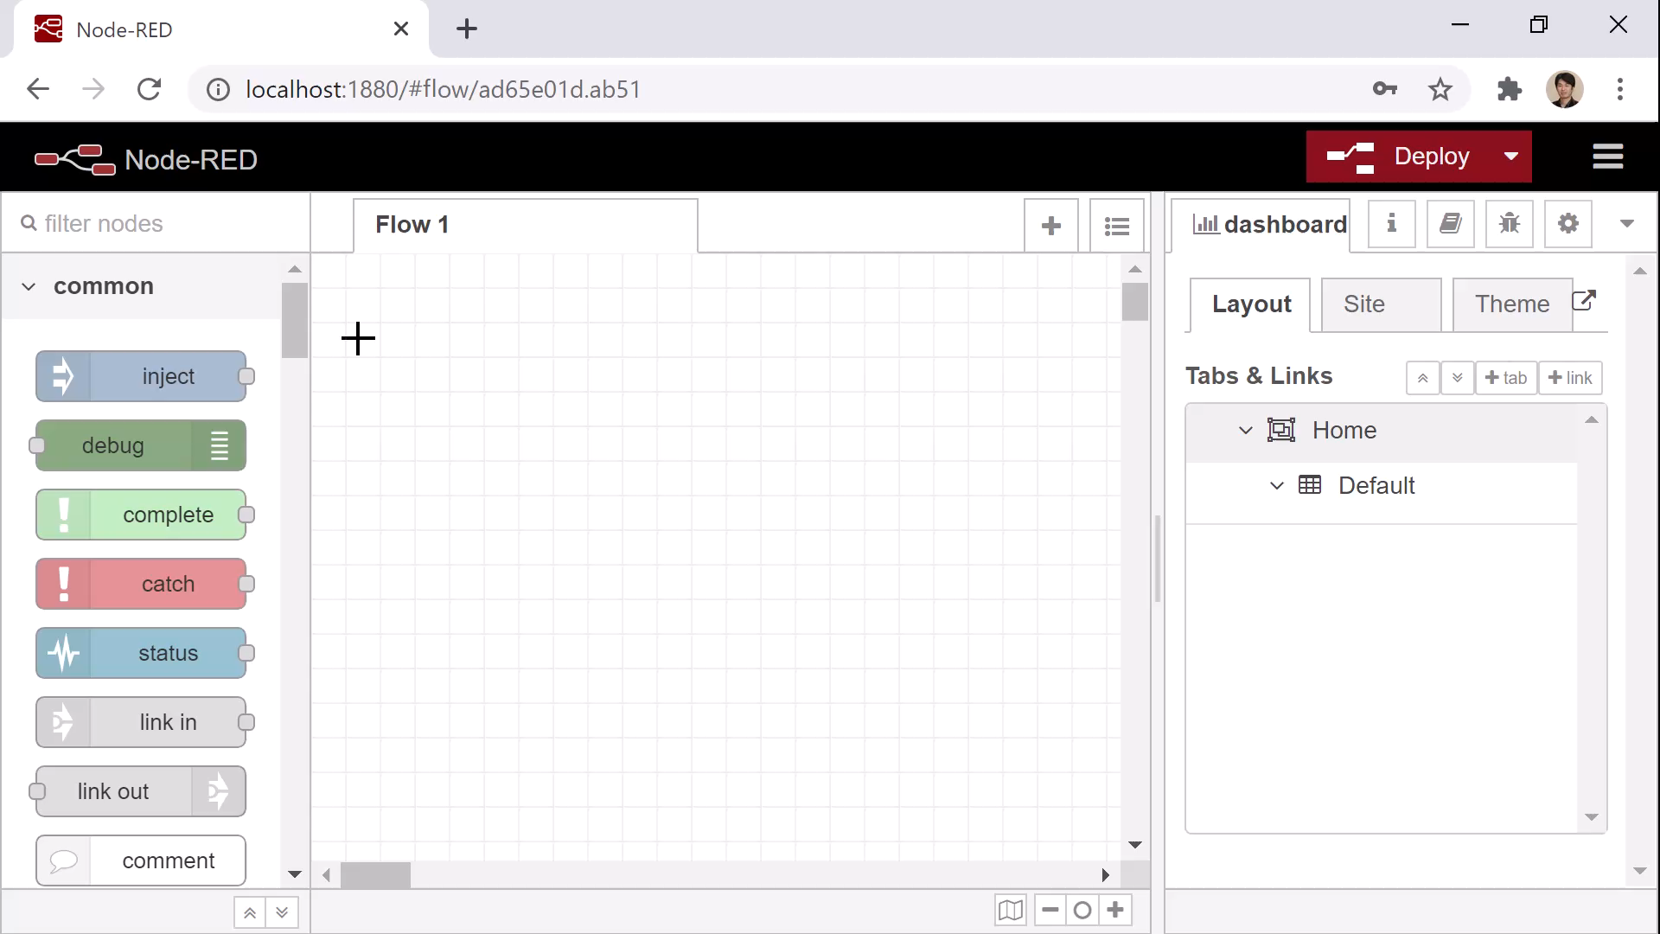

Slide 5


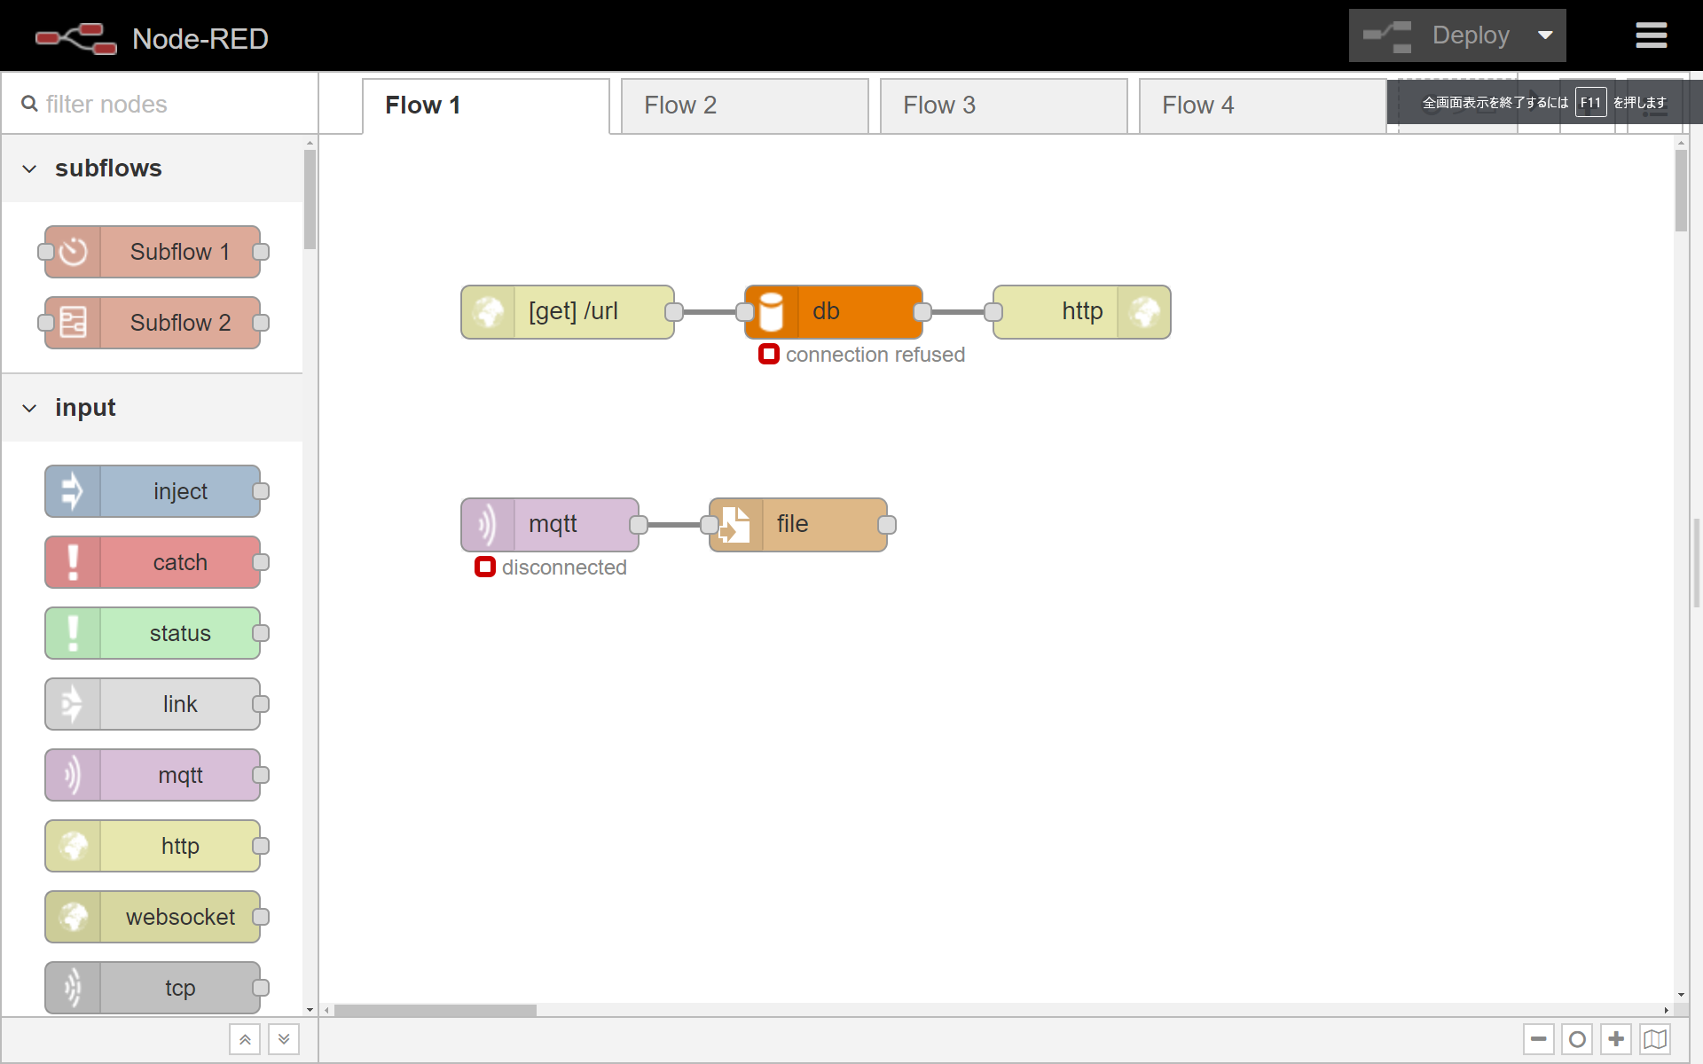
Documentation about middleware for http-in node
We investigated the middleware to limit rate of incoming message.
And we also have a plan to investigate the authentication using middleware.
Current
To be
Many access
Many access
Express
-rate
-limit
Large queue leads crush
Drop the message
To avoid crash

Slide 6
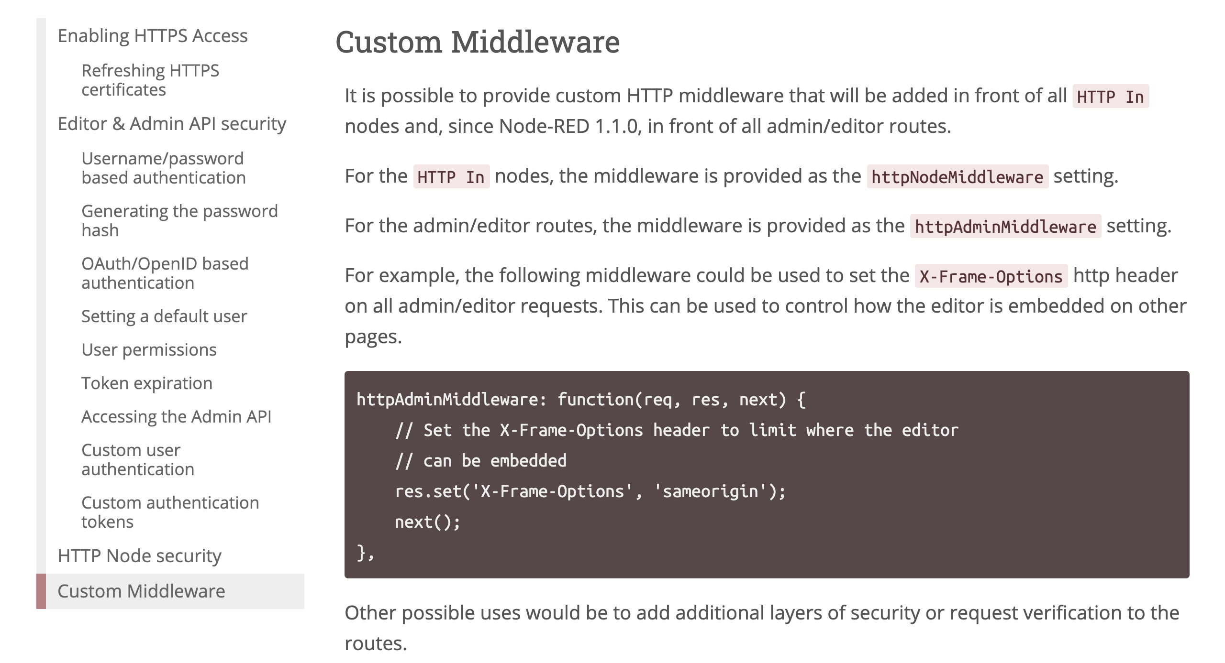
Documentation about middleware for http-in node
https://nodered.org/docs/user-guide/runtime/securing-node-red#custom-middleware
# | Question
1 | Can we add the example of middleware to the official website after our investigation?
We would like to add
more information
about middleware

Slide 7
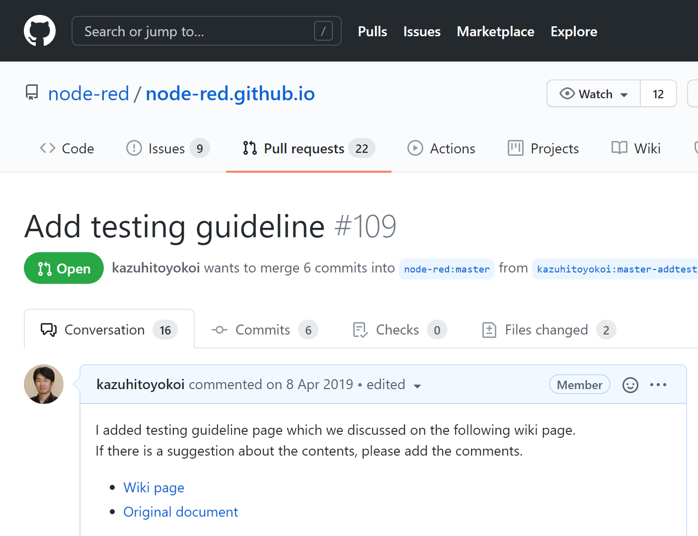
Documentation
Dashboard user guide
We are going to publish the document from the next month
Node testing guide (Ready to merge)
https://github.com/node-red/node-red.github.io/pull/109

Slide 8
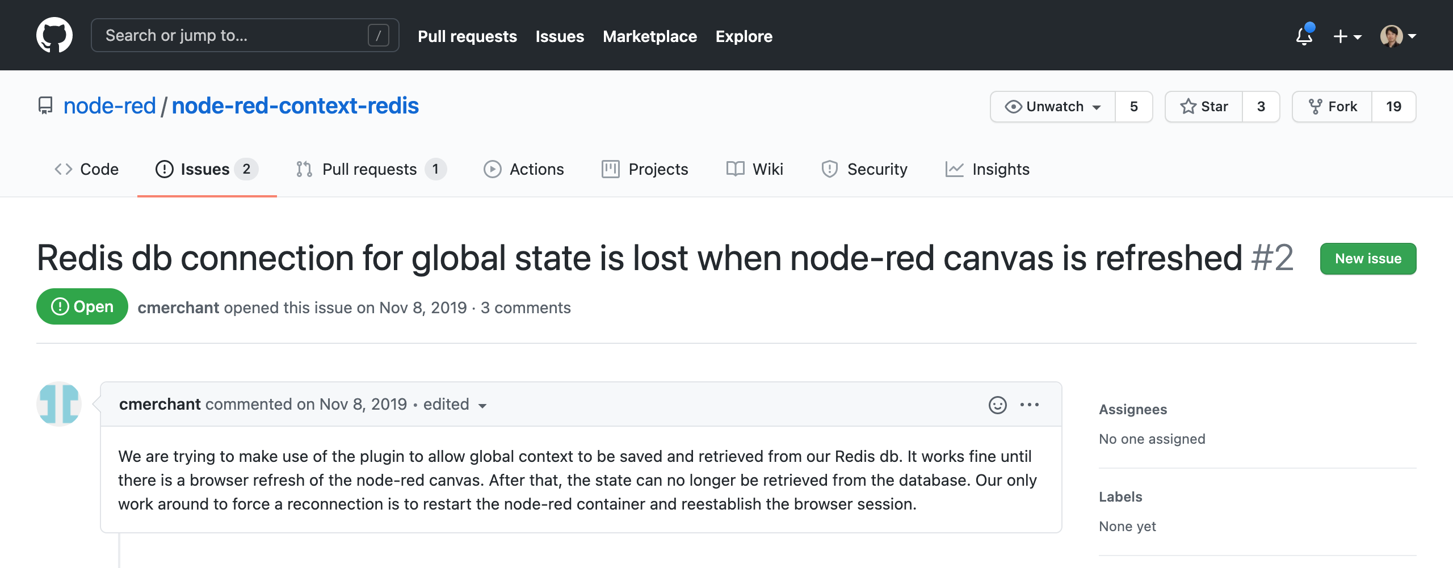
Redis & SQLite context plugin
To merge the pull request of Redis plugin for Persistent store,
Ito-san will focus on the following issue.
https://github.com/node-red/node-red-context-redis/issues/2
As the next step, we will develop SQLite plugin because the current
implementation writes entire data to a file every update.

